Slide 1
LM317 Automation #1
Week 8a

Slide 2


Slide 3
Textbook …
You should have already studied Chapters 5-6 in Boysen & Kybett – if not, then do so ASAP …
We’ll skip Ch. 7, Resonant circuits. I encourage you to read it, but it will be hard to do the experiments with your kits, because you don’t have a good choice of inductors, and resonant frequencies tend to be higher than we can reliably measure (100’s of kHz)
Ch. 8, Transistor amplifiers – focus on what is biasing, but otherwise you can safely skip. We’ll discuss emitter followers more simply in lecture, and spend some time on op-amps
Ch. 9, Oscillators – we’ll make one with a function generator IC kit, so we don’t have to worry about oscillator theory
Ch. 10, Transformers; Ch. 11 Power supply circuits, we’ll skip – we built a cool PS with an IC, so we’re essentially done!!
STUDY carefully CHAPTERS 5 and 6, AC CIRCUITS and FILTERS, and revisit prior chapters – and we’re done with the book!!

Slide 4
What next?
Automate control of the LM317
Enable the Arduino to effectively turn the LM317’s knob
Enable Matlab to control the LM317, without loosing manual knob
How we do this is more important educationally, so I want to show you the process I went through to engineer this novel solution
Explore AC … time varying voltages and signals, for the rest of the semester
Build a function generator
Construct an oscilloscope (in software) to display time-varying signals (much better than Serial Plotter)
Automate control of function generator’s frequency
Final project will be a portfolio of your previous labs (minus your least favorite one). That’s all folks!!
We’ll mix up 1 and 2 … we’ll need AC concepts to do #1.

Slide 5
Automating the LM317
We’ve seen how Matlab can send and receive data from Arduino through the serialport object and hardware
How can Matlab tell Arduino to control the LM317’s voltage?
LM317 is pure analog – it has no digital interface
The Arduino has an analogwrite()function … might that help??
Let’s imagine Arduino produces an analog voltage … how might a variable DC voltage control the LM317?
The LM317 datasheet must have the answer (or at least clues)
“Top down” and “bottom up” refer to two complementary approaches to engineering
We’ve broken or cut the automation task into 3 big conceptual pieces (Hardware, software, data interfaces) – that’s a “top-down” approach
Building those pieces, even before we know how they can fit together, is a “bottom-up” approach
When is one approach better than the other??
If you know what you’re doing, then top-down can be more efficient
If you’re uncertain (as we are now), then bottom-up can reduce uncertainties – so that’s how we’ll proceed now

Slide 6
Existing Bottom-Up view
Our apparatus was like this
LM317
Vout = 1.25(1+R2/R1)
Circuit/device under test
(DUT)
R2
Vout
analogRead
Arduino
Nano
Copy/paste
MATLAB
(plot, …)
Serial
Serial Monitor
Copy/paste
Increasing abstraction
Word
Lab Report

Slide 7


Existing Bottom-Up view
Adding explicitly some key human interfaces
LM317
Vout = 1.25(1+R2/R1)
Circuit/device under test
(DUT)
R2
Vout
analogRead
Arduino
Nano
Copy/paste
MATLAB
(plot, …)
Serial
Serial Monitor
digitalRead (trigger)
Copy/paste
Context, analysis, generalization, …
Word
Lab Report

Slide 8
Rearranged Top-Down View
(Hands and brain are implicit)
The direct Arduino/Matlab interface appears simpler …
Conceptually, and/or practically?
Lab Report
MATLAB
(plot, .mlx, …)
Arduino
Nano
analogRead
Serialport
Serial
Copy/paste
Serial Monitor
LM317
Vout = 1.25(1+R2/R1)
Circuit & DUT
R2
Vout

Slide 9
LM317 Automation
Our goal now is to add LM317 control
E.g., hardware, software, data interfaces and their details
Lab Report
MATLAB
(plot, .mlx, …)
Arduino
Nano
analogRead
Serialport
Serial
From the top view, can you envision another possible way to do this?
Control
LM317
Vout = 1.25(1+R2/R1)
Circuit & DUT
R2
Vout

Slide 10
LM317 Control
A reductionist approach to figuring out control is focusing on the two interfaces – to the Arduino and to the LM317, and then designing ”glue” that mates them
Recall our first design project – the LED nightlight. To connect a wall wart to an LED, we characterized each (i.e., Thevenin voltage and i-v curve), and then designed an interface (i.e., series resistor value) to connect them. We’ll attempt to repeat that pattern
The Arduino has an analogWrite()function … might that help??
Let’s imagine Arduino produces an analog voltage … how might a variable DC voltage control the LM317?
The LM317 datasheet might have the answer (or at least clues)

Slide 11
LM317 Control
I emphasize, at this point, we’re guessing, exploring – trying to find/make a ”bridge” between two disconnected things (Arduino and LM317)
When this “lost”, top-down design is often worthless speculation
But we can constructively explore and learn more about the ”bottom” – how does R2 control the LM317, and how (and what) does analogWrite() do?

Slide 12
Explore analogWrite();
Down the second rabbit hole first…
Arduino→ File → Examples → Analog → AnalogInOutSerial might be an efficient place to start
Draw a schematic of the hardware interface described in the comments (I hate to do it for you … practice before going to the next slide!)

Slide 13
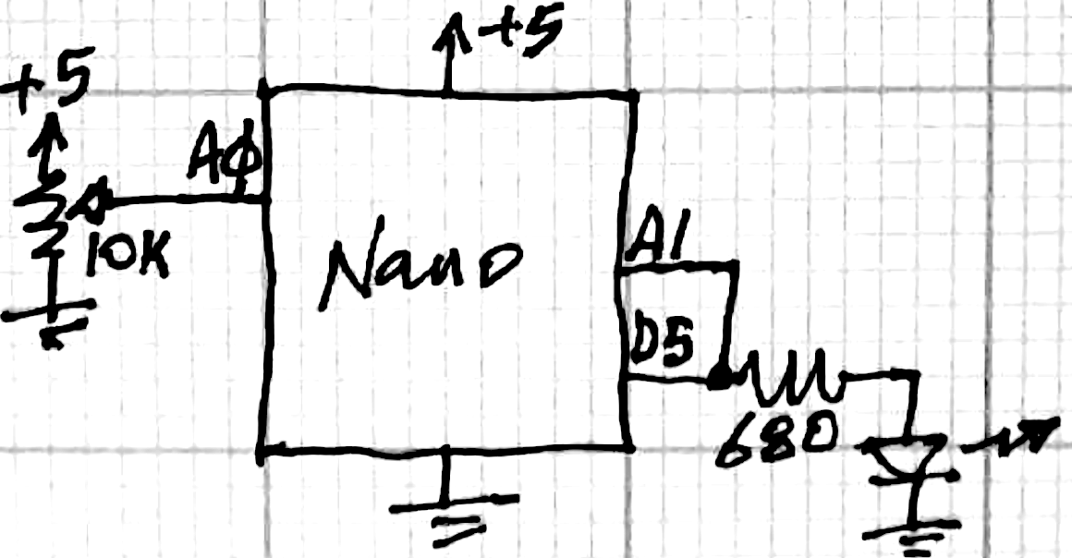
Reflection
analogWrite() is hardly analog – it’s a digital output that flips between 0 and 1 ~ 5V fast
We don’t need to interface with voltage dividers and protection because D5 voltages can’t damage A1 … (Arduino can’t hurt itself)
2. To make DC from this, we need a “filter” to output the average voltage and smooth out the highs and lows by holding charge (should sound like a … capacitor)
Personal reflection: Rasnow spent >>8 hours putting this activity together. The following circuits and slides are a few out of dozens of variations I tried by simulation and measurement.
I can’t teach you electronics. I can create a context for you to teach yourselves…
I hope you learn from both the upcoming journey and destination …

Slide 15
Today’s Goals
Capacitors and AC – This will be the most mathematical day of the semester … fasten your seat belts!
Ask questions before getting tooooo lost
I recommend these videos about complex numbers; Kahn Academy, etc.:
https://www.youtube.com/watch?v=TEk5filRg7s
https://www.youtube.com/watch?v=19c4c3SwtS8

Slide 16
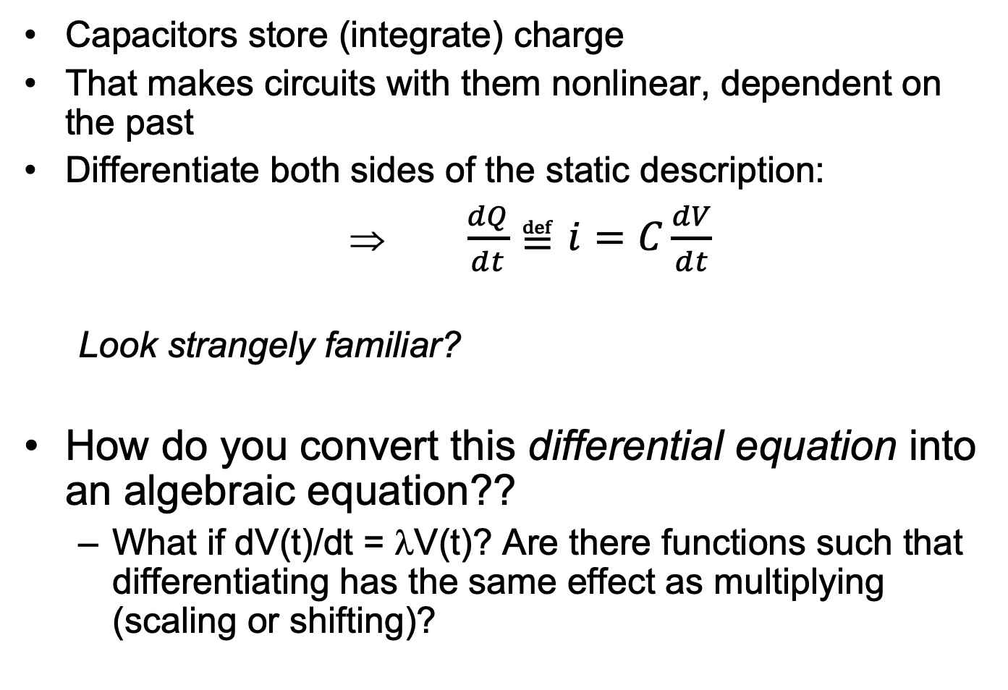
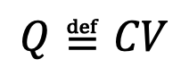
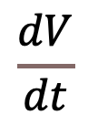
Capacitors in Detail
Capacitors store (integrate) charge
That makes circuits with them nonlinear, dependent on the past
Differentiate both sides of the static description:
⇒ $\frac{dQ}{dt}≝i=C\frac{dV}{dt}$
Look strangely familiar?
How do you convert this differential equation into an algebraic equation??
What if dV(t)/dt = λV(t)? Are there functions such that differentiating has the same effect as multiplying (scaling or shifting)?
i
$$Q≝CV$$
Slope = C
$$\frac{dV}{dt}$$

Slide 17
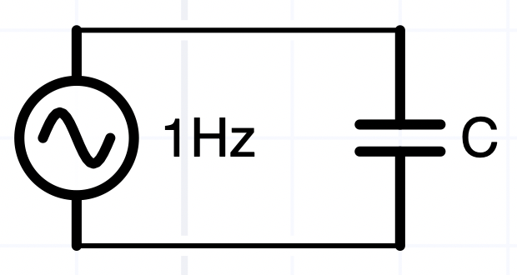
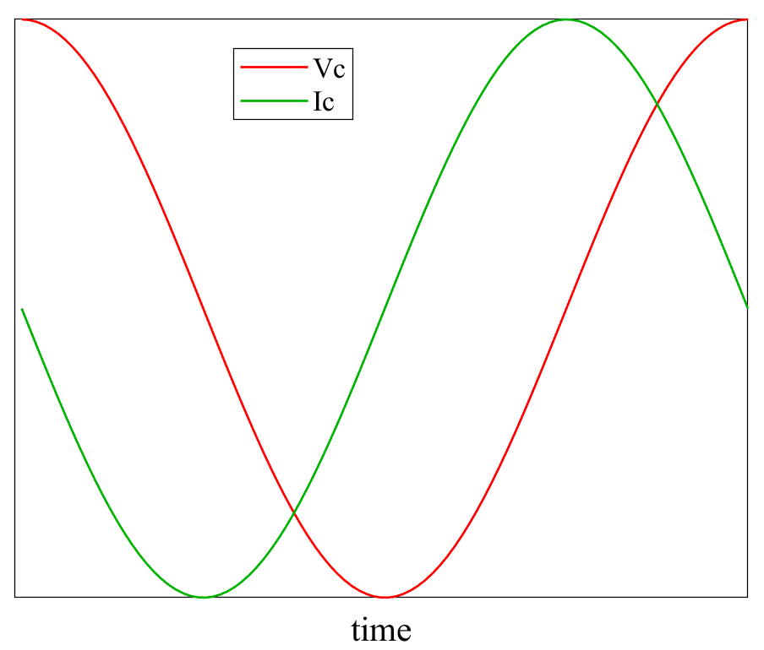
What’s the current?
i(t)
V(t)
If V(t) = V₀ then i=0 after the capacitor charges to V_{0,} ie. dV(t)/dt=0V(t) → V= V₀ = const is a solution, albeit a boring one
If V(t) = V₀cos(ωt), then
i = CdV/dt = -Cωsin(ωt)
With foresight, we can also write i = -Cωcos(ωt+π/2)
The voltage and current are phase shifted
We’ll have to keep track of both amplitudes and phases when dealing with AC voltages

Slide 18
Algebra → ODEs → Complex Algebra
We don’t want to solve ODE’s ...
Try separation of variables so
Note: in electronics, j=sqrt(-1), and sometimes s = jω
Differentiation is the same as multiplication by jω!!
Q = CV_{C}→ i = dQ/dt = CdV_{C}/dt = jωCV
The ratio V/i =1/ jωC has units of R It’s called “impedance”
→ We converted the differential equation to an algebraic one, but …
Can V(t) always be separated as above?
What do these complex numbers mean?
V(t)
₀

Slide 19
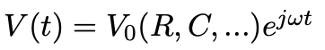
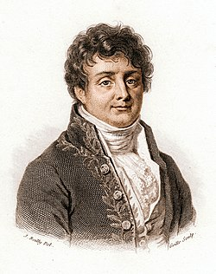

Algebra → ODEs → Complex Algebra
Can V(t) always be separated:
Yes if the circuit is linear, i.e., if superposition applies
Joseph Fourier gave us this remarkable result and a recipe to do it, “Fourier Analysis”
https://en.wikipedia.org/wiki/Fourier_analysis
What does a complex voltage or current mean?
Multimeter only shows the amplitude (more $$ AC meters can show phase too)
Complex numbers provide an algebraic, computational, trick to keep track of phases of voltages and currents
Leonard Euler gave us the recipe
https://en.wikipedia.org/wiki/Euler's_formula

Slide 20
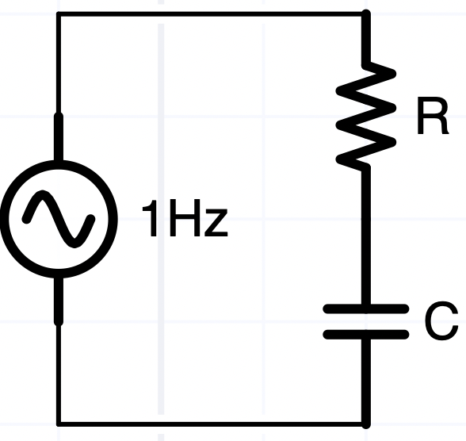
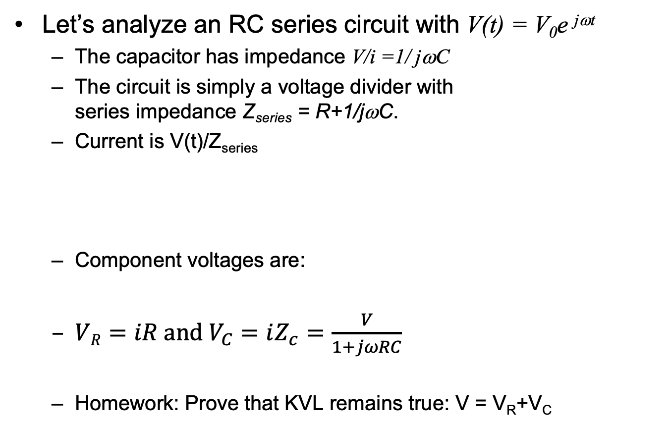
Algebra → ODEs → Complex Algebra
Let’s analyze an RC series circuit with V(t) = V₀e ^{jωt}
The capacitor has impedance V/i =1/ jωC
The circuit is simply a voltage divider with series impedance Z_{series} = R+1/jωC.
Current is V(t)/Z_{series}
Component voltages are:
$VR=iR and V_{C}=iZ_{c}=\frac{V}{1+jωRC}$
Homework: Prove that KVL remains true: V = V_{R}+V_{C}
V₀e^{jωt}

Slide 21
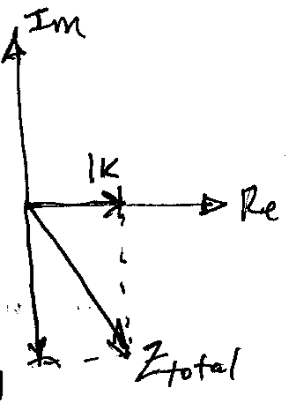
Why … (mathematical aside)
Capacitors have frequency-dependent impedances
The functional dependence on time isn’t arbitrary
Complex exponentials are eigenfunctions of linear operators
i.e., d/dt(e^{jωt}) = λ(e^{jωt})
These special functions are invariant (other than scaling), so they form a natural basis for understanding the dynamics
…
Geometrically, in the Complex plane, Zc is orthogonal to R, so the series impedance is the vector sum of the two
Zseries is sometimes called a “phasor”
R
Zc

Slide 22
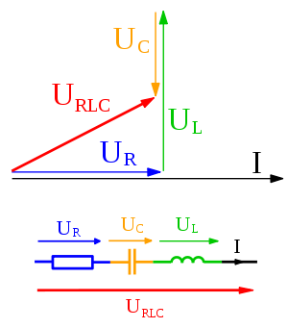

Phasors ≠ phasers
https://en.wikipedia.org/wiki/Phasor
Wikipedia uses U instead of Z for impedance …
One of these is dangerous … the other is a toy

Slide 23
Another mathematical aside
Teaching physics got me wondering if our use of the “+” symbol with vectors maybe confusing
The “+” symbol has 2 different meanings
Actually more …
Do you agree that the sum of two parallel vectors of length a and b is a third vector parallel to them of length (a+b)?
a and b are (generally) real numbers, and “+” has exactly its usual meaning as the sum of those numbers
If our 2 vectors are not parallel, then what is their sum?

Slide 24
Sum of 2 vectors
Two ways to answer this are geometrically and algebraically …
The geometrical recipe is to put the head of one on the tail of the other, the sum is the vector …
Algebraically
Define a basis, a set of unit vectors (that span the vector space
Determine the components of the two vectors (e.g., by projecting each onto its unit basis vectors)
Add the corresponding components …
Never add different components to each other algebraically

Slide 25
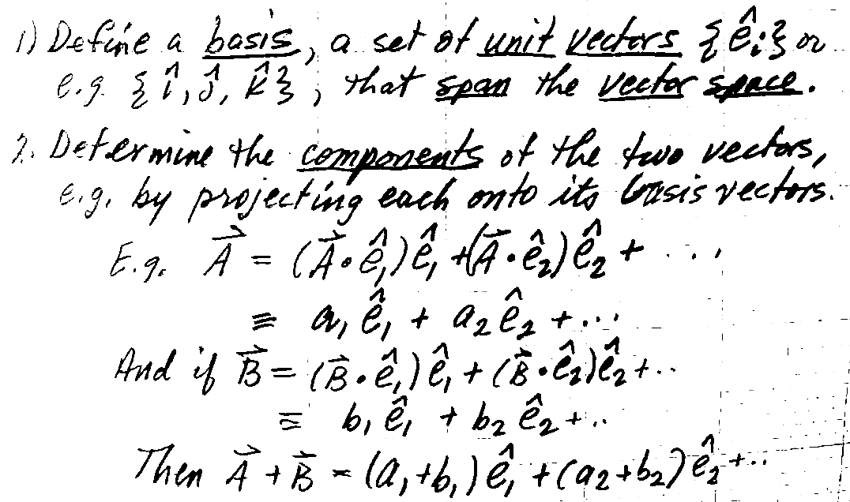
Sum of 2 vectors
Algebraically
Do you see 2 distinct meanings of “+”?

Slide 26
Algebraic notation for vectors
The blue “+” are conventional addition of numbers
The red “+” are not! They represent the addition of 2 vectors, that have to follow the “head to tail” rule explained in the geometrical representation
Comments?
Complex numbers z=a+jb are like 2-d vectors in having 2 distinct components, which have to be combined by specific rules (i.e., never simply add a’s to b’s …)
Z1 + Z2 = (a1+a2) + j(b1+b2)

Slide 27
Why complex numbers?
Why not use 2-d vectors, where we agree the x-components are amplitudes and the y-components are phases?
That doesn’t work because adding 2π to the phase doesn’t change it – phase is cyclical
Just like j² = -1 and j⁴ = 1, so j⁵ = j, …
Complex number algebra gives the right answers, whereas real vector algebra doesn’t
If you really want to know why … consider becoming a mathematician or physicist instead of an engineer … ;-)
“This is a hammer, this is how you can use it. This is Fourier analysis, this is how you can use it. …”

Slide 28
Summary (KEY SLIDE!!)
That was some gnarly math, so let’s summarize and conceptualize …
Circuits with sinusoidal voltage sources, capacitors, resistors (and inductors) will exhibit sinusoidal voltages and currents (with different amplitudes and phases)
To compute those amplitudes and phases, instead of calculus, treat a capacitor’s impedance algebraically as a complex number
Z = 1/(jωC) = 1/(j2πfC), impedance changes with frequency (so we solve the circuit at each frequency of interest separately)
Complex impedances and numbers are a book-keeping trick, to deal with phase, which doesn’t exist in DC circuits.
The rules of complex algebra give the right answers
Let’s now simulate an RC series circuit in Matlab …

